Slide 1
Introduction to Signals & Systems

Slide 2
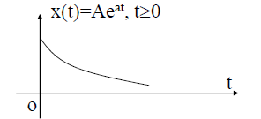
Introduction to Signals
A Signal is the function of one or more independent variables that carries some information to represent a physical phenomenon.
A continuous-time signal, also called an analog signal, is defined along a continuum of time.

Slide 3
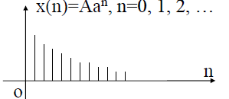
A discrete-time signal is defined at discrete times.

Slide 4
Elementary Signals
Sinusoidal & Exponential Signals
Sinusoids and exponentials are important in signal and system analysis because they arise naturally in the solutions of the differential equations.
Sinusoidal Signals can expressed in either of two ways :
cyclic frequency form- A sin 2Пf_{o}t = A sin(2П/T_{o})t
radian frequency form- A sin ω_{o}t
ω_{o} = 2Пf_{o} = 2П/T_{o}
T_{o} = Time Period of the Sinusoidal Wave

Slide 5
Sinusoidal & Exponential Signals Contd.
x(t) = A sin (2Пf_{o}t+ θ)
= A sin (ω_{o}t+ θ)
x(t) = Ae^{at Real Exponential}
= Ae^{jω̥t =} A[cos (ω_{o}t) +j sin (ω_{o}t)] ^{Complex Exponential}
θ = Phase of sinusoidal wave
A = amplitude of a sinusoidal or exponential signal
f_{o} = fundamental cyclic frequency of sinusoidal signal
ω_{o} = radian frequency
Sinusoidal signal

Slide 6
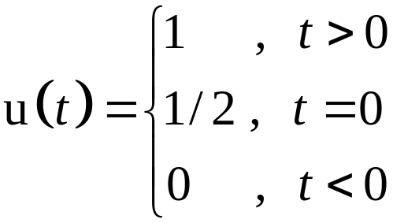
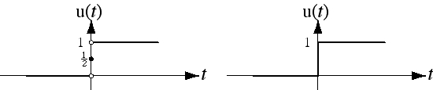
Unit Step Function
Precise Graph
Commonly-Used Graph

Slide 7
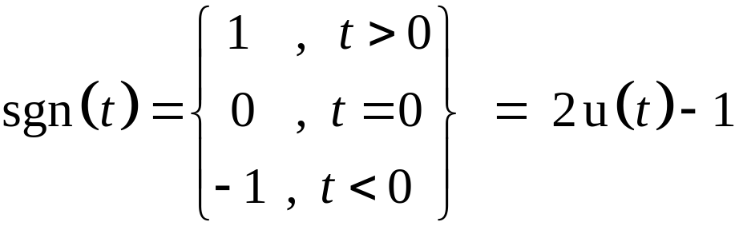
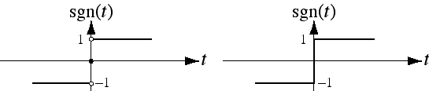
Signum Function
Precise Graph
Commonly-Used Graph
The signum function, is closely related to the unit-step
function.

Slide 8
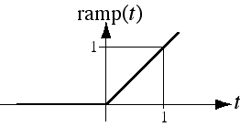
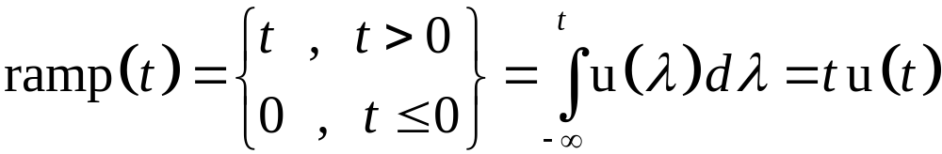
Unit Ramp Function
The unit ramp function is the integral of the unit step function.
It is called the unit ramp function because for positive t, its
slope is one amplitude unit per time.

Slide 9
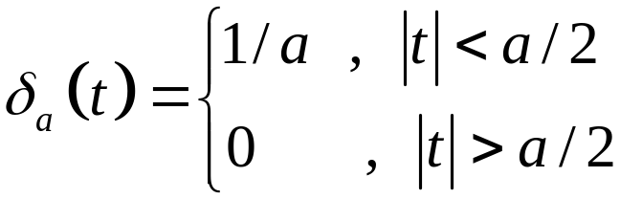
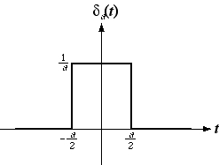
Rectangular Pulse or Gate Function
Rectangular pulse,

Slide 10
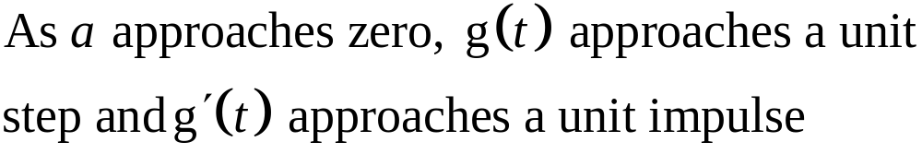
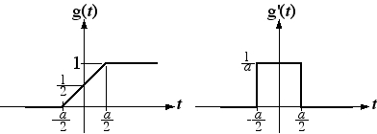
Unit Impulse Function
Functions that approach unit step and unit impulse
So unit impulse function is the derivative of the unit step
function or unit step is the integral of the unit impulse function

Slide 11
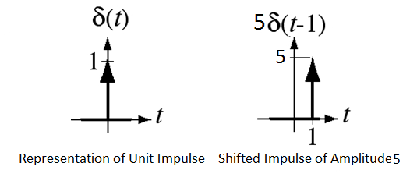
Representation of Impulse Function
The area under an impulse is called its strength or weight.
It is represented graphically by a vertical arrow. An impulse with a strength of one is called a unit impulse.

Slide 12
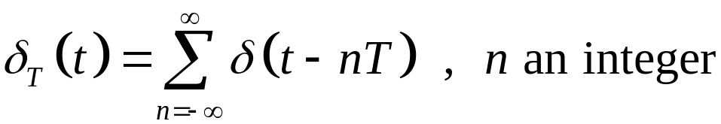
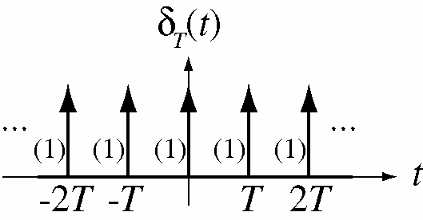
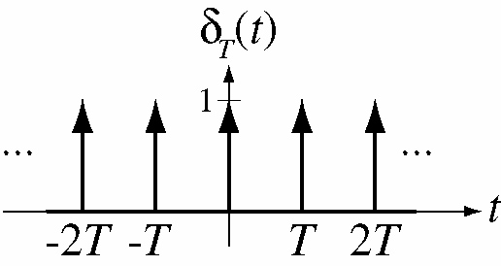
Unit Impulse Train
The unit impulse train is a sum of infinitely uniformly-
spaced impulses and is given by

Slide 13

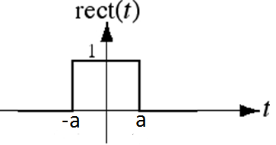
The Unit Rectangle Function
The unit rectangle or gate signal can be represented as combination of two shifted unit step signals as shown

Slide 14
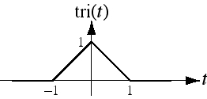
The Unit Triangle Function
A triangular pulse whose height and area are both one but its base width is not, is called unit triangle function. The unit triangle is related to the unit rectangle through an operation called convolution.

Slide 15
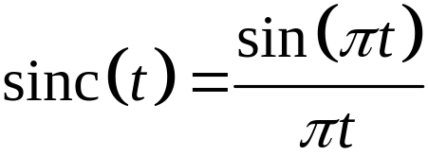
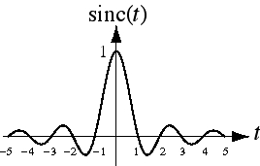
Sinc Function

Slide 16
Discrete-Time Signals
Sampling is the acquisition of the values of a continuous-time signal at discrete points in time
x(t) is a continuous-time signal, x[n] is a discrete-time signal

Slide 17
Discrete Time Exponential and Sinusoidal Signals
DT signals can be defined in a manner analogous to their continuous-time counter part
x[n] = A sin (2Пn/N_{o}+θ)
= A sin (2ПF_{o}n+ θ)
x[n] = a^{n}
n = the discrete time
A = amplitude
θ = phase shifting radians,
N_{o} = Discrete Period of the wave
1/N₀ = F_{o} = Ω_{o}/2 П = Discrete Frequency
Discrete Time Sinusoidal Signal
Discrete Time Exponential Signal

Slide 18
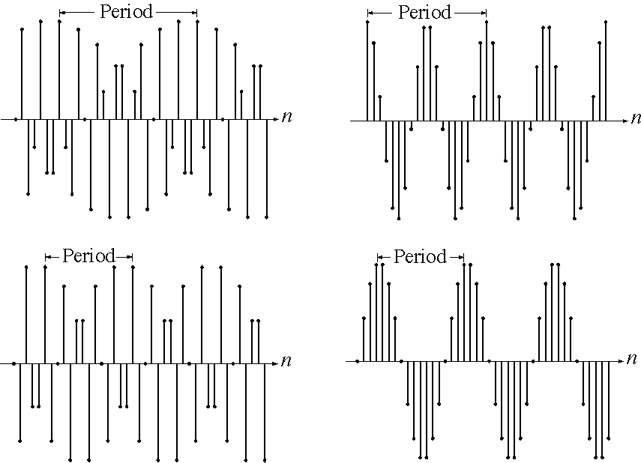
Discrete Time Sinusoidal Signals

Slide 19
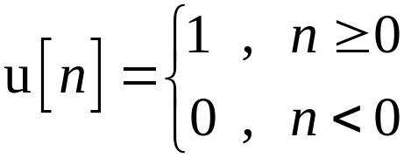
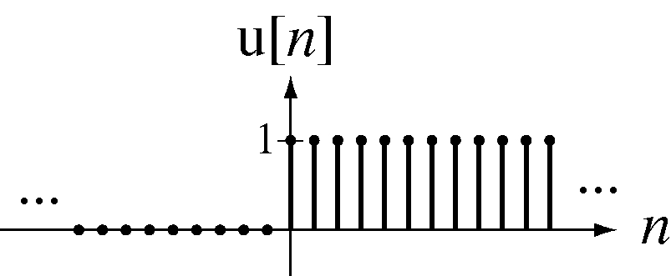
Discrete Time Unit Step Function or Unit Sequence Function

Slide 20
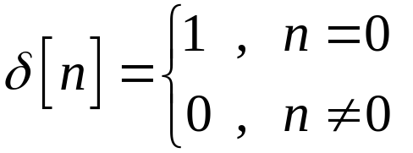
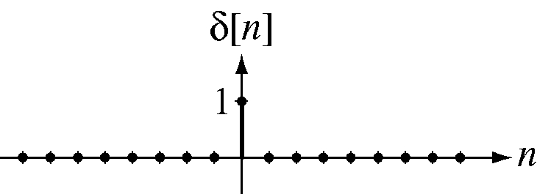
Discrete Time Unit Impulse Function or Unit Pulse Sequence

Slide 21
Operations of Signals
Sometime a given mathematical function may completely describe a signal .
Different operations are required for different purposes of arbitrary signals.
The operations on signals can be
Time Shifting
Time Scaling
Time Inversion or Time Folding

Slide 22
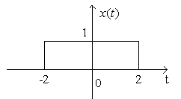
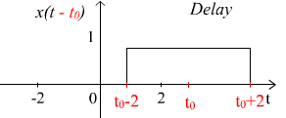
Time Shifting
The original signal x(t) is shifted by an amount tₒ.
X(t)→X(t-to) →Signal Delayed→ Shift to the right

Slide 23
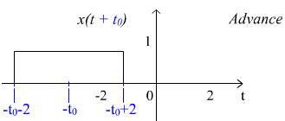
Time Shifting Contd.
X(t)→X(t+to) →Signal Advanced→ Shift to the left

Slide 24
Time Scaling
For the given function x(t), x(at) is the time scaled version of x(t)
For a ˃ 1,period of function x(t) reduces and function speeds up. Graph of the function shrinks.
For a ˂ 1, the period of the x(t) increases and the function slows down. Graph of the function expands.

Slide 25
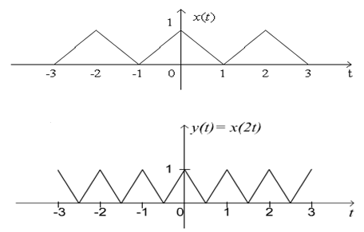
Time scaling Contd.
Example: Given x(t) and we are to find y(t) = x(2t).
The period of x(t) is 2 and the period of y(t) is 1,
Notes:
Example: fast forwarding / slow playing

Slide 26
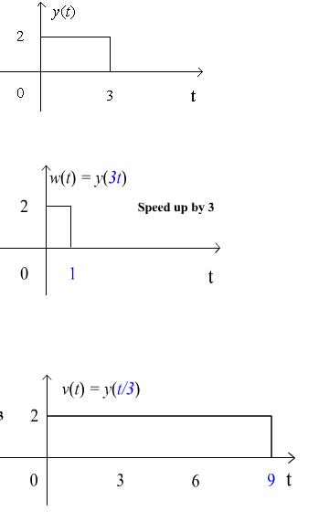
Time scaling Contd.
Given y(t),
  find w(t) = y(3t)
  and v(t) = y(t/3).

Slide 27
Time Reversal
Time reversal is also called time folding
In Time reversal signal is reversed with respect to time i.e.
y(t) = x(-t) is obtained for the given function

Slide 28
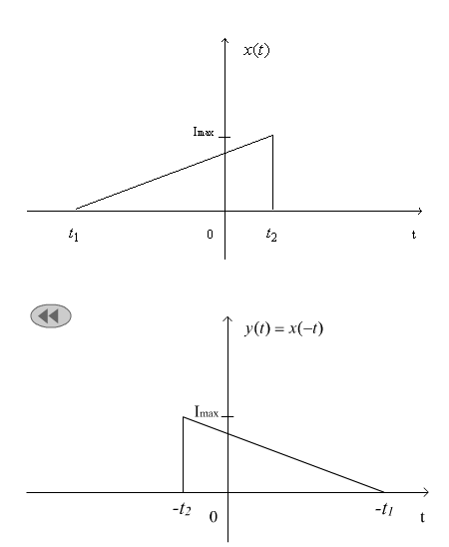
Time reversal Contd.
Notes:
Example: Playing a tape recorder backward
Beatle Revolution 9 is said be played backward!

Slide 29
Classification of Signals
Deterministic & Non Deterministic Signals
Periodic & A periodic Signals
Even & Odd Signals
Energy & Power Signals

Slide 30
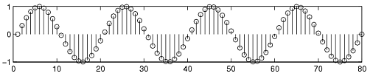
Deterministic & Non Deterministic Signals
Deterministic signals
Behavior of these signals is predictable w.r.t time
There is no uncertainty with respect to its value at any time.
These signals can be expressed mathematically.
For example x(t) = sin(3t) is deterministic signal.

Slide 31

Deterministic & Non Deterministic Signals Contd.
Non Deterministic or Random signals
Behavior of these signals is random i.e. not predictable w.r.t time.
There is an uncertainty with respect to its value at any time.
These signals can’t be expressed mathematically.
For example Thermal Noise generated is non deterministic signal.

Slide 32
Periodic and Non-periodic Signals
Given x(t) is a continuous-time signal
x (t) is periodic iff x(t) = x(t+Tₒ) for any T and any integer n
Example
  x(t) = A cos(ωt)
  x(t+Tₒ) = A cos[ω(t+Tₒ)] = A cos(ωt+ωTₒ)= A cos(ωt+2π) = A cos(ωt)
  Note: Tₒ =1/fₒ ; ω=2πfₒ

Slide 33
Periodic and Non-periodic Signals Contd.
For non-periodic signals
x(t) ≠ x(t+Tₒ)
A non-periodic signal is assumed to have a period T = ∞
Example of non periodic signal is an exponential signal

Slide 34
Important Condition of Periodicity for Discrete Time Signals
A discrete time signal is periodic if
x(n) = x(n+N)
For satisfying the above condition the frequency of the discrete time signal should be ratio of two integers
i.e. fₒ = k/N

Slide 35
Sum of periodic Signals
X(t) = x1(t) + X2(t)
X(t+T) = x1(t+m₁T₁) + X2(t+m₂T₂)
m₁T₁=m₂T₂ = Tₒ = Fundamental period
Example: cos(tπ/3)+sin(tπ/4)
  T1=(2π)/(π/3)=6; T2 =(2π)/(π/4)=8;
  T1/T2=6/8 = ¾ = (rational number) = m2/m1
  m₁T₁=m₂T₂ → Find m1 and m2→
  6.4 = 3.8 = 24 = Tₒ

Slide 36
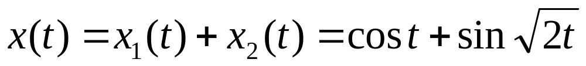
Sum of periodic Signals – may not always be periodic!
  T1=(2π)/(1)= 2π; T2 =(2π)/(sqrt(2));
  T1/T2= sqrt(2);
  Note: T1/T2 = sqrt(2) is an irrational number
  X(t) is aperiodic

Slide 37


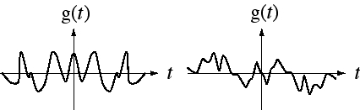
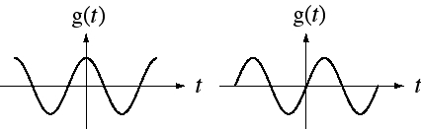
Even and Odd Signals
Even Functions
Odd Functions

Slide 38
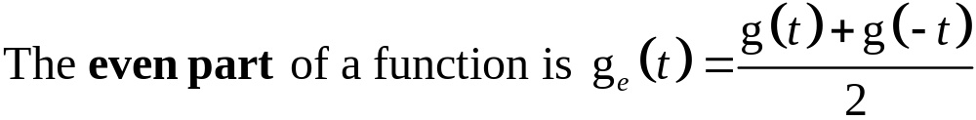
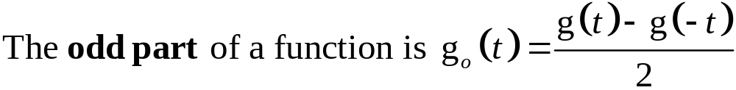
Even and Odd Parts of Functions
A function whose even part is zero, is odd and a function
whose odd part is zero, is even.

Slide 39
Derivatives and Integrals of Functions
Function type | Derivative | Integral
Even | Odd | Odd + constant
Odd | Even | Even

Slide 40
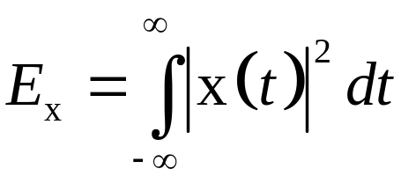
Energy and Power Signals
Energy Signal
A signal with finite energy and zero power is called Energy Signal i.e.for energy signal
0<E<∞ and P =0
Signal energy of a signal is defined as the area under the square of the magnitude of the signal.
The units of signal energy depends on the unit of the signal.

Slide 41
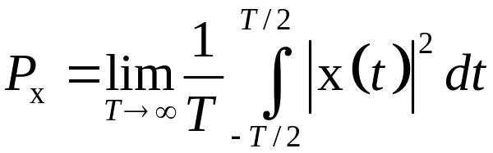
Energy and Power Signals Contd.
Power Signal
Some signals have infinite signal energy. In that caseit is more convenient to deal with average signal power.
For power signals
0<P<∞ and E = ∞
Average power of the signal is given by

Slide 42
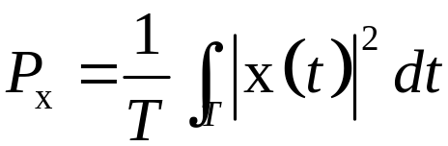
Energy and Power Signals Contd.
For a periodic signal x(t) the average signal power is
T is any period of the signal.
Periodic signals are generally power signals.

Slide 43
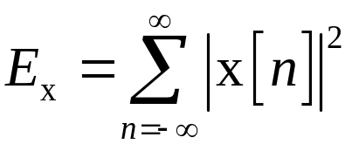
Signal Energy and Power for DT Signal
A discrtet time signal with finite energy and zero power is called Energy Signal i.e.for energy signal
0<E<∞ and P =0
The signal energy of a for a discrete time signal x[n] is

Slide 44
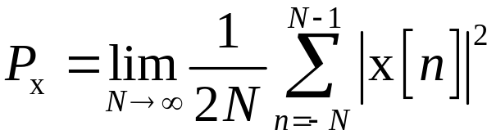
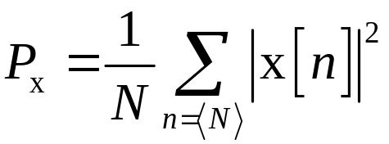
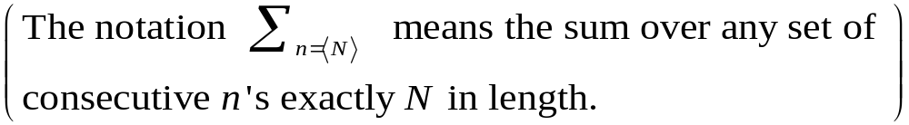
Signal Energy and Power for DT Signal Contd.
The average signal power of a discrete time power signal
x[n] is
For a periodic signal x[n] the average signal power is

Slide 45
What is System?
Systems process input signals to produce output signals
A system is combination of elements that manipulates one or more signals to accomplish a function and produces some output.
input signal
output signal
system

Slide 46
Examples of Systems
  A circuit involving a capacitor can be viewed as a system that transforms the source voltage (signal) to the voltage (signal) across the capacitor
  A communication system is generally composed of three sub-systems, the transmitter, the channel and the receiver. The channel typically attenuates and adds noise to the transmitted signal which must be processed by the receiver
  Biomedical system resulting in biomedical signal processing
  Control systems

Slide 47
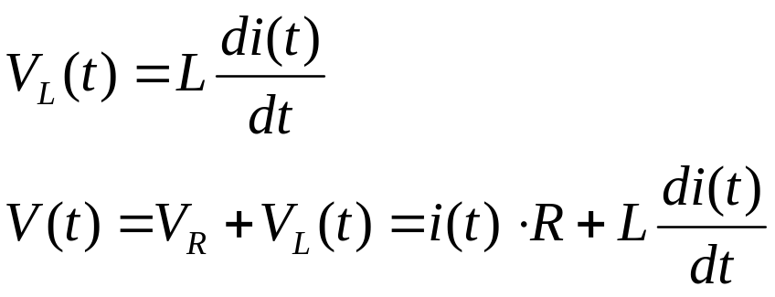
System - Example
Consider an RL series circuit
  Using a first order equation:
R
L
V(t)

Slide 48
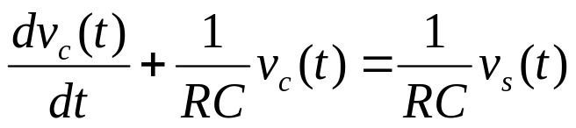
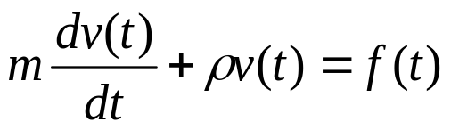
Mathematical Modeling of Continuous Systems
Most continuous time systems represent how continuous signals are transformed via differential equations.
E.g. RC circuit
System indicating car velocity

Slide 49
Order of System
Order of the Continuous System is the highest power of the derivative associated with the output in the differential equation
For example the order of the system shown is 1.

Slide 50

Order of System Contd.
Order of the Discrete Time system is the highest number in the difference equation by which the output is delayed
For example the order of the system shown is 1.

